Slide 1
My Favorite Foods

Slide 2
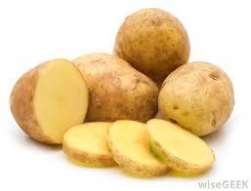
Potatoes
I like all kinds: mashed, baked, fried or grilled. I think if I had to, I could live off of potatoes.

Slide 3
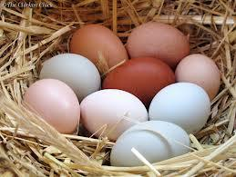
Eggs
I know eggs have been thought to raise one’s cholesterol, but it’s one of my favorite foods at breakfast or any other time of day.

Slide 4
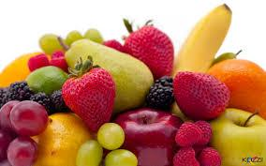
Fruit
For many reasons, Summer is my favorite time of the year, but one of the things I love most about Summer is I get to enjoy all of my fresh, favorite fruits!

Slide 5
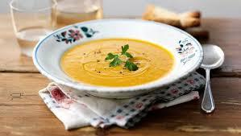
Soup
Soups are great this time of year, but I love them all year long. Soup is another food that I could probably eat once each day and not get tired of it.

